Slide 1

BLINKIT SALES DATA

Slide 2

WELCOME TO BLINKIT
Hello this Chelukala Swetha , This project involves a comprehensive data analysis of the Blinkit Grocery Sales Data to uncover key sales drivers, item performance, and outlet characteristics that influence total revenue. The primary objective is to transform raw data into actionable business insights using SQL for data querying and analysis, and Excel for preliminary data cleaning, visualization, and reporting.

Slide 3

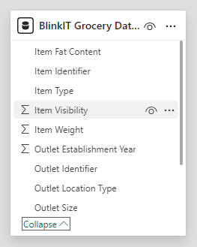
Blinkit Grocery Data Schema

Slide 4

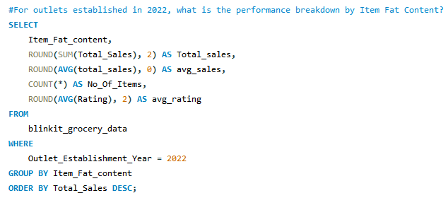
Output

Slide 5

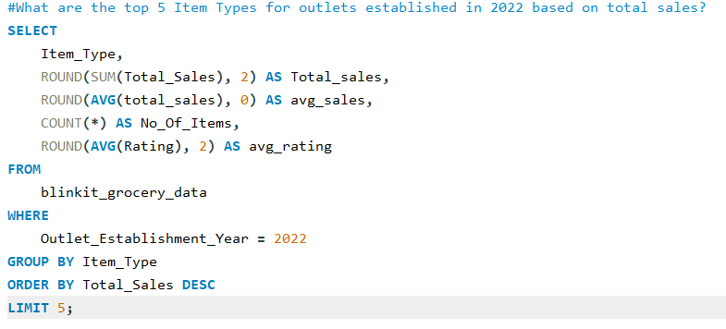
Output

Slide 6
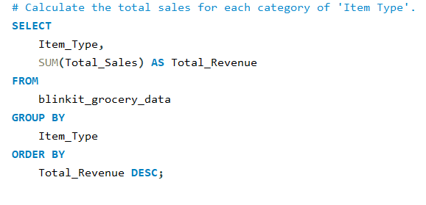
Output

Slide 7

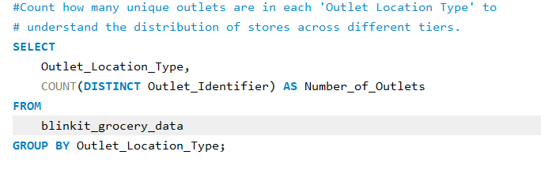
Output

Slide 8

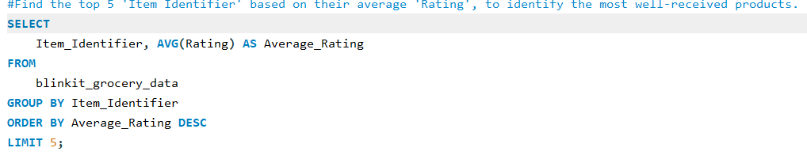
Output

Slide 9

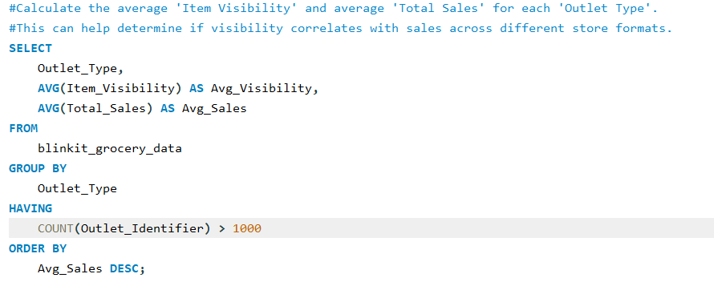
Output

Slide 10
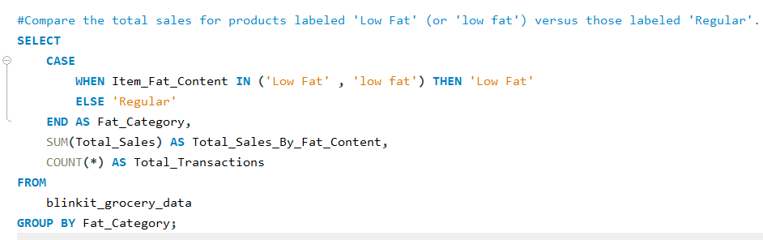

Output

Slide 11

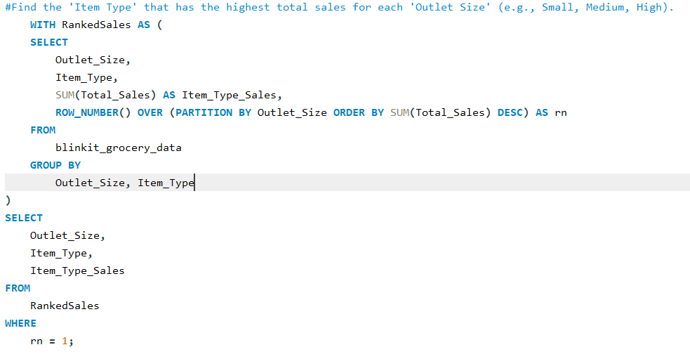
Output

Slide 12

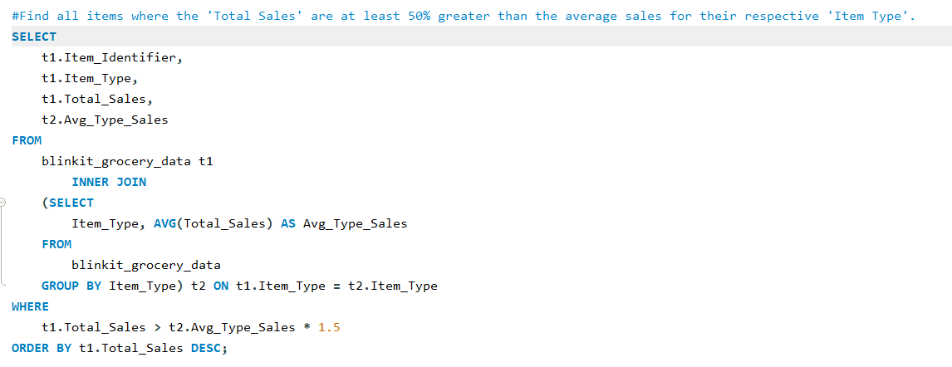
Output

Slide 13


